Slide 1
Exploratory Data Analysis
Customer Personality Analysis Dataset
Module 04 — Machine Learning Internship | AI Lab 99

Slide 2
Agenda
What this analysis covers
1
Dataset Overview
2
Customer Demographics
3
Spending Analysis
4
Purchasing Behavior & Website Engagement
5
Recency & Campaign Performance
6
Correlation Analysis
7
Customer Segmentation
8
Business Insights & Recommendations
AI Lab 99 — Module 04: EDA
2

Slide 3
Dataset Overview
Clean, validated data ready for analysis
2,237
33
0
0
Customer Records
Variables
Missing Values
Duplicate Records
The dataset covers customer demographics, purchasing behaviour across web, catalogue and store channels, marketing campaign responses, complaints, and website engagement — fully cleaned in the prior preprocessing module.
AI Lab 99 — Module 04: EDA
3

Slide 4
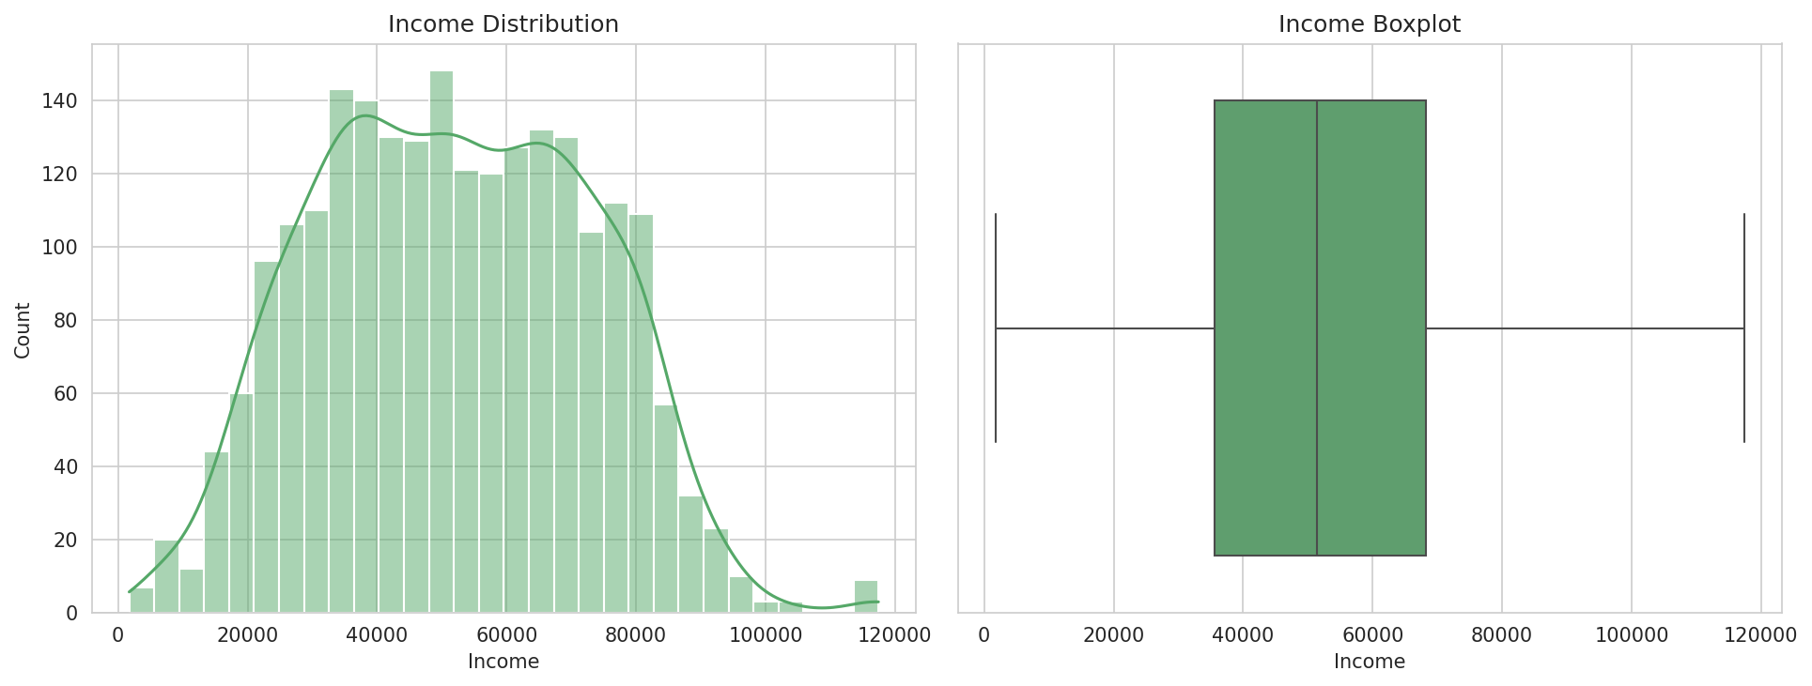
Customer Demographics
Income distribution across the customer base
Key Facts
• Average age: 57.1 years (range 30–86)
• Average income: $51,855
• Most customers hold a Graduation-level degree
• Majority are Married or Together
AI Lab 99 — Module 04: EDA
4

Slide 5
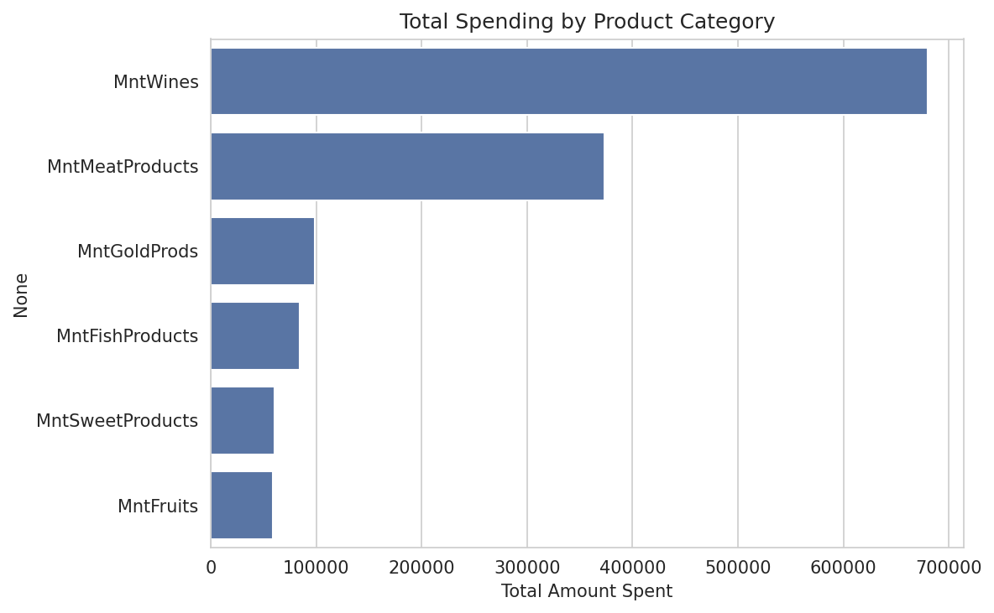
Spending Analysis
Wine leads all product categories
Highlights
• Total spend: $1,355,048
• Avg. spend/customer: $605.74
• Wine generates the highest revenue
• Fruits generate the least revenue
AI Lab 99 — Module 04: EDA
5

Slide 6
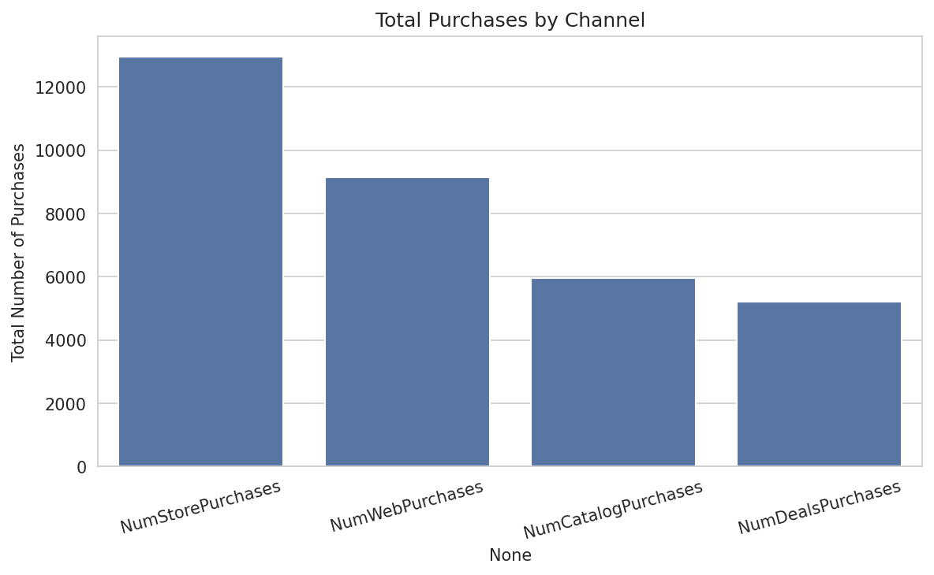
Purchasing Behavior
Store purchases remain the top channel
Channel Totals
• Store: 12,962 purchases
• Web: 9,143 purchases
• Catalogue: 5,956 purchases
• Deal-driven: 5,205 purchases
AI Lab 99 — Module 04: EDA
6

Slide 7
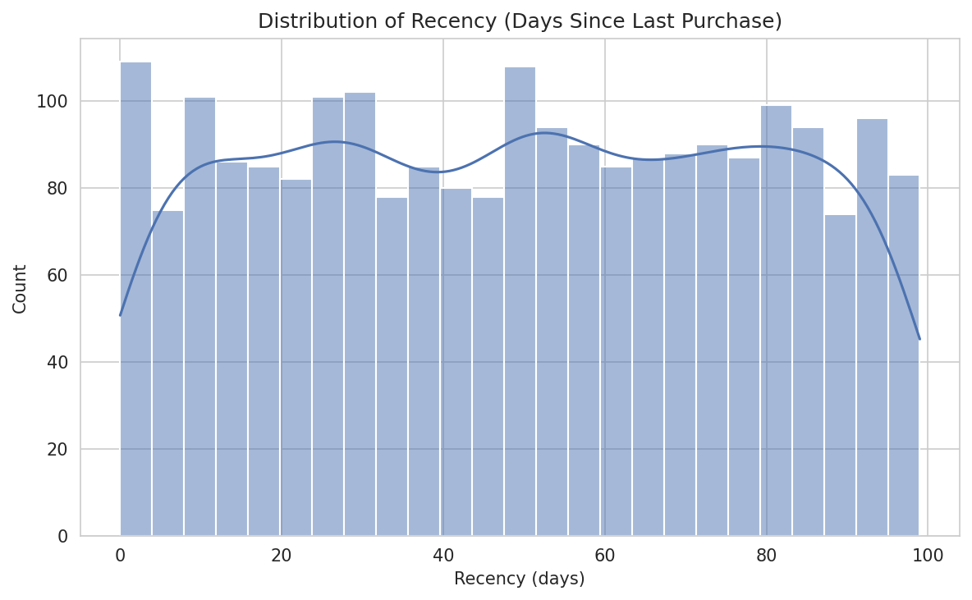
Recency & Re-engagement
1 in 4 customers needs a win-back campaign
533
customers with Recency > 75 days
These are prime candidates for targeted re-engagement / win-back offers.
AI Lab 99 — Module 04: EDA
7

Slide 8
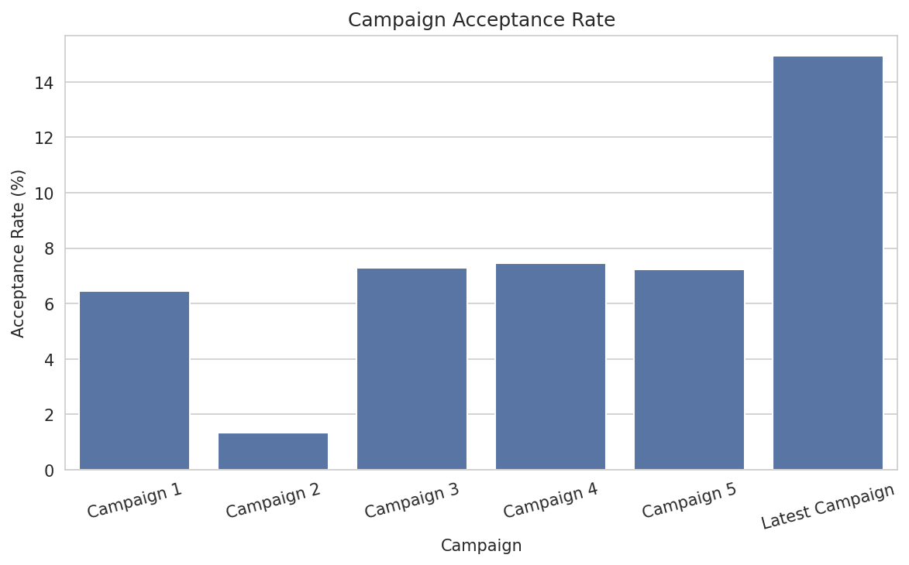
Marketing Campaign Performance
The latest campaign nearly doubled prior acceptance rates
Acceptance Rates
• Latest Campaign: 14.93% (best)
• Campaign 4: 7.47%
• Campaign 2: 1.34% (worst)
• 239 customers accepted 2+ campaigns
AI Lab 99 — Module 04: EDA
8

Slide 9
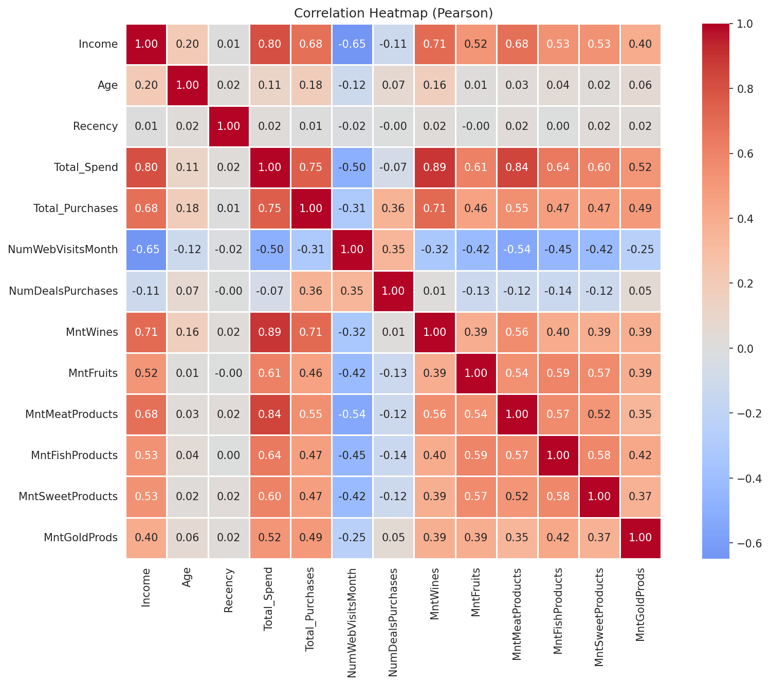
Correlation Analysis
Income and spending move together
AI Lab 99 — Module 04: EDA
9

Slide 10
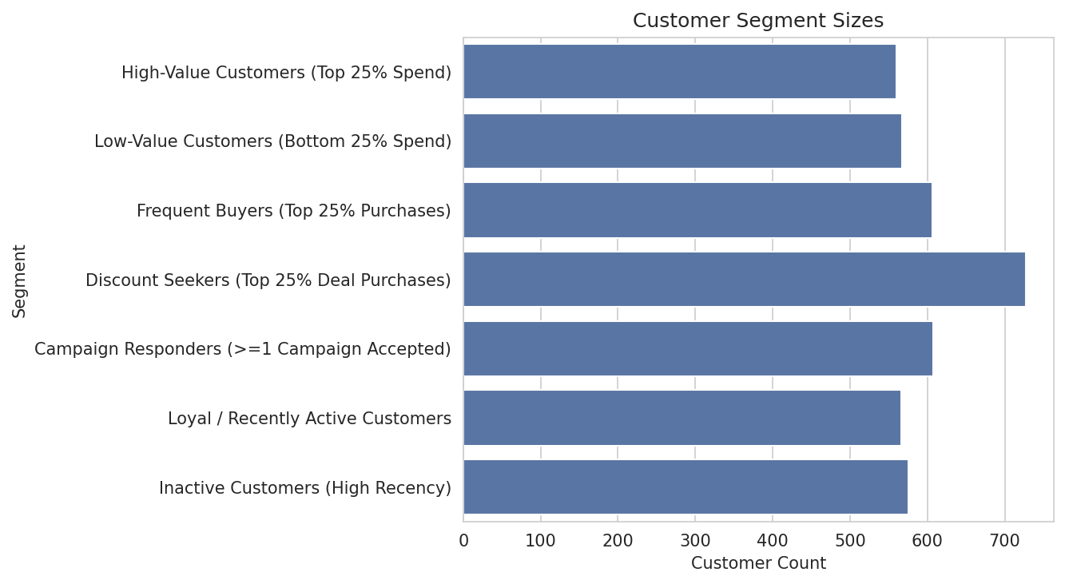
Customer Segmentation
Quartile-based behavioural segments
Segment Sizes
• High-Value: 560 (25.0%)
• Discount Seekers: 727 (32.5%)
• Campaign Responders: 608 (27.2%)
• Inactive: 576 (25.7%)
AI Lab 99 — Module 04: EDA
10

Slide 11
Key Business Insights
High-income, older, fewer-children households spend the most
Wine drives the highest category revenue
Income strongly predicts spending (r ≈ 0.80)
Store purchases remain the most popular channel
Households with children spend ~63% less than those without
~26% of customers are inactive and need re-engagement
AI Lab 99 — Module 04: EDA
11

Slide 12
Recommendations
Launch win-back campaigns for the ~26% inactive segment
Build premium bundles around Wine & Meat for high-value customers
Investigate low web-visit-to-purchase conversion
Offer value-oriented promotions to households with children
Replicate the design of the top-performing latest campaign
Feed Income, Total Spend, Recency & Purchases into segmentation models
AI Lab 99 — Module 04: EDA
12

